Slide 1
MANUFACTURING PET BOTTLES
PRT presentation

Slide 2
MADE BY:
1. PRATEEK RAJDEV
2. SAGAR GHAI
3. SWAPNIL SHARMA
4. TUSHAR JAIN
5. SIDDHARTH GANGAL

Slide 3
MANUFACTURING MATERIAL
PET = polyethylene terephthalate
Thermoplastic polymer
60% demand in fibres
30% demand in bottle production
Not effected by a large no of chemical reactions…
Carbonation- the fizz process……
Derived from oil and is formed from polymerization reaction between acid and alcohol.

Slide 4
RECYCLING
NON-BIODEGRADABLE
Hence recycled and mixed with the original mixture of PET in a 1:3 ratio.
Recycling has not kept pace with manufacturing
Land fills/ inceneration of waste.
In 1980, US pet recycling was 9.6 % but risen today to 32%.
Recycling provides 5 jobs for every job in Landfills.

Slide 5
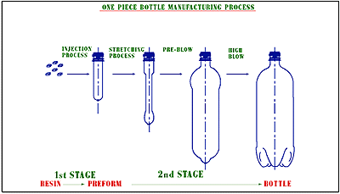

Slide 6
INJECTION MOULDING
Pellets or granules fed into heated cylinder
Melt is forced into a split-die chamber
Molten plastic pushed into mold cavity
Pressure ranges from 70 Mpa – 200 Mpa
Mixture of resin with 2 or more reactive fluids forced into the mold cavity at high speed .

Slide 7
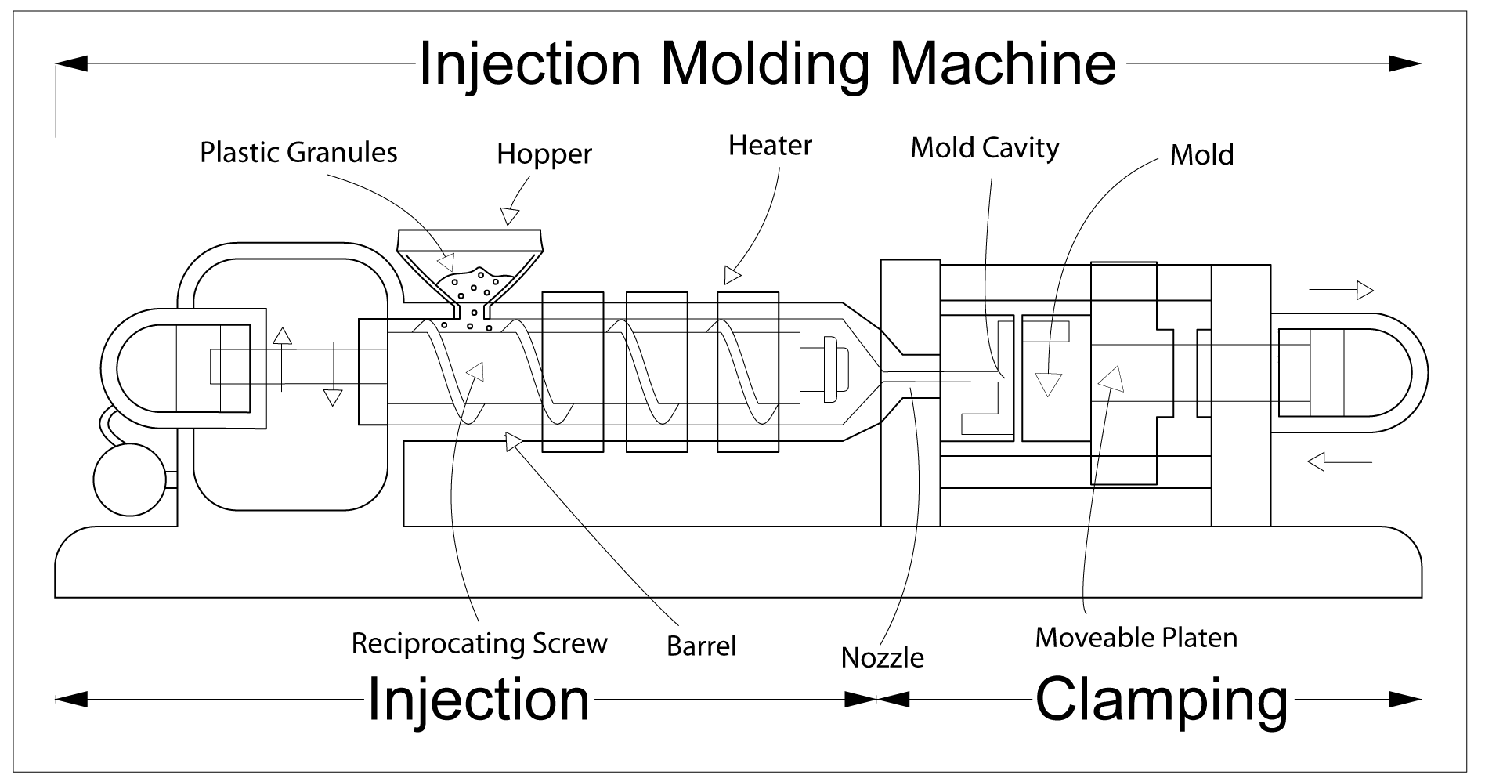
INJECTION MOULDING
This is a process in which the plastic is formed into the mould.
PET is heated and placed in a mould of a thin long tube.
The tube of PET(parison) is now transferred to a second bottle shaped mould.
A thin steel rod(mantrel) is slid inside the parison and fills it with pressurized air.

Slide 8
Blow molding
Modified extrusion and Injection Molding process.
A tube extruded then clamped to mold with cavity larger than tube diameter.
Finally blown outward to fill the cavity
Pressure 350Kpa-700Kpa

Slide 9
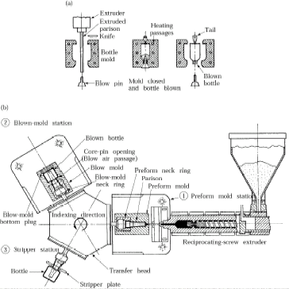
Blow molding
Fig : Schematic illustration of (a) the blow-molding process for making plastic beverage bottles, and (b) a three-station injection blow-molding machine.

Slide 10
Bottle manufacture
Blow molding

Slide 11
Process capabilities :
High production rates
Good dimensional control
Cycle time range 5 to 60 sec’s
Mold materials- tool steels, beryllium - Cu, Al
Mold life- 2 million cycles (steel molds)
10000 cycles ( Al molds)
Machines :
Horizontal or vertical machines
Clamping – hydraulic or electric

Slide 12
MARKET ANALYSIS IN INDIA
500 % increase in use over last decade.
1.5 million tonnes of plastic used.
5% per year, reaching 227 million
tonnes in 2015.annual growth rates in consumption exceeding
20%. Plastic consumption per head of population in India is 5 kg, representing a total
volume of 9 million tonnes in 2010, compared with the global average of 26 kg

Slide 13
And THAT is how it’s done!

Slide 14
Thank you

